Slide 1
Spring Tools for
Development and Production

Slide 2
Spring DevTools
spring-boot-devtools

Slide 3
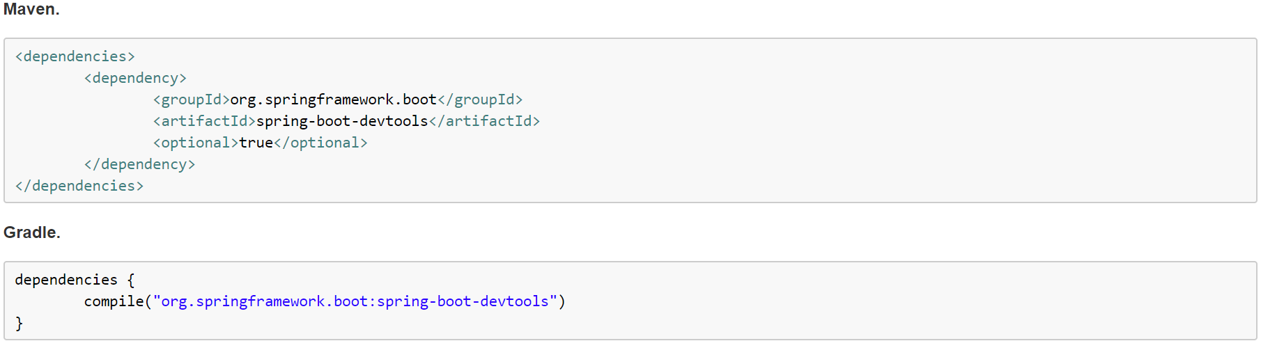
What is DevTools?
A Spring Boot module designed to improve the development-time experience.

Slide 4
Useful Uses for Utilizing DevTools
Automatic cache configuration
Many ways to configure automatic application restart
Automatic browser refresh extension
Global configuration settings
Remote update and hosting for applications
Logging changes to show before and after implementations

Slide 5
Automatic Restart
Automatically restart whenever files on the classpath change. By default, any entry on the classpath that points to a folder is monitored for changes. Static resources are not monitored by default.
The entire project is not restarted when a class is updated. Instead, any files not changed when the restart is triggered are simply reloaded.

Slide 6
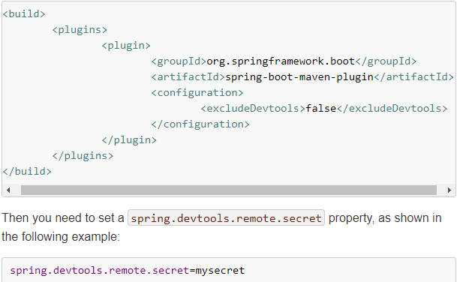
Remote Applications
The Spring Boot developer tools are not limited to local development. You can also use several features when running applications remotely. However, remote support is opt-in.
To enable it, you need to make sure that devtools is included in the repackaged archive

Slide 7
Global Settings
You can configure global devtools settings by adding a file named “.spring-boot-devtools.properties” to a “$HOME” folder.
Any properties added to the file apply to all Spring Boot applications on the machine that use devtools
An example to configure restart to always use a trigger file:

Slide 8

Turn Off for Production
Developer tools are automatically disabled when running a fully packaged application. If your application is launched using java -jar, then it is considered a “production application”. Flagging the dependency as optional is the normal best practice.
If you want to ensure that devtools is never included in a production build, you can also use the “excludeDevtools” build property to completely remove the JAR. The property is supported with both the Maven and Gradle plugins.

Slide 9
Spring Actuator
spring-boot-starter-actuator

Slide 10
What is Actuator?
The engineering definition: “An actuator is a manufacturing term that refers to a mechanical device for moving or controlling something. Actuators can generate a large amount of motion from a small change.”
Spring Actuator is the Spring Boot module for production features
Provides monitoring, metrics, and auditing
Supports different technologies for exposing data
HTTP
Java Management Extensions (JMX)

Slide 11
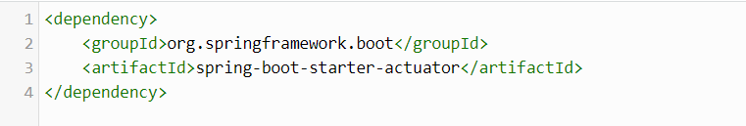
Enabling Spring Boot Actuator

Slide 12
Major Core Feature of Actuators: Endpoints
Actual URI endpoints that display Actuator-provided information about your application and services
Built-in endpoints are provided by Spring
Default amount of endpoints exposed upon importing the actuator dependency: 16
Spring also supports customized endpoint configuration in application.properties
A built in endpoint can be customized by enabling or disabling it, by customizing its sensitivity and id, or by implementing the interface Endpoint.

Slide 13
Common Cool Actuator Endpoints
/health – Shows application health information (a simple ‘status’ when accessed over an unauthenticated connection or full message details when authenticated)
not sensitive by default
/info – Displays arbitrary application info
not sensitive by default
/metrics – Shows ‘metrics’ information for the current application
sensitive by default
/trace – Displays trace information
the last few HTTP requests by default

Slide 14
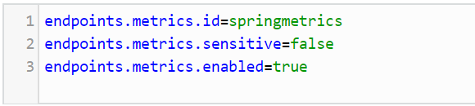

Customized Endpoint: Metrics

Slide 15
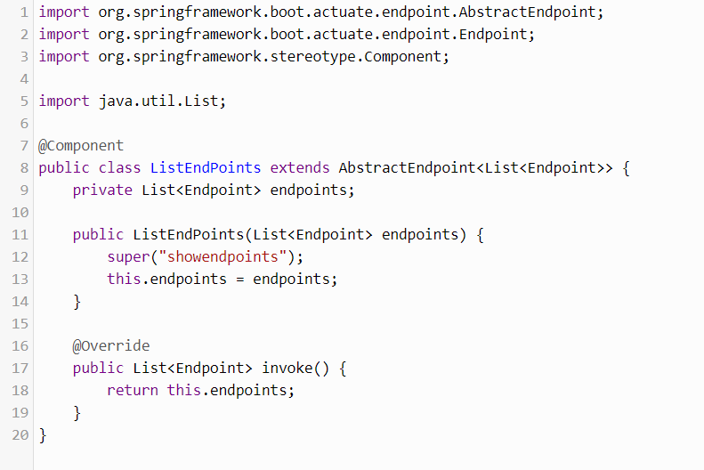
Defining a New Endpoint

Slide 16
Accessing Secured Endpoints
There are only two endpoints, health and info, that are by default not sensitive.
Other endpoints are sensitive and require authorization to access.
Sensitive endpoints can be accessed by disabling the sensitivity or securing it using Spring Security or AuthenticationManagerBuilder.

Slide 17
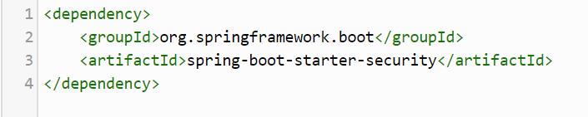
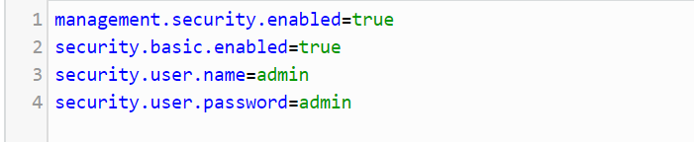
Securing Endpoints: Spring Security
Notes:
enables the restricted actuator endpoints.

Slide 18
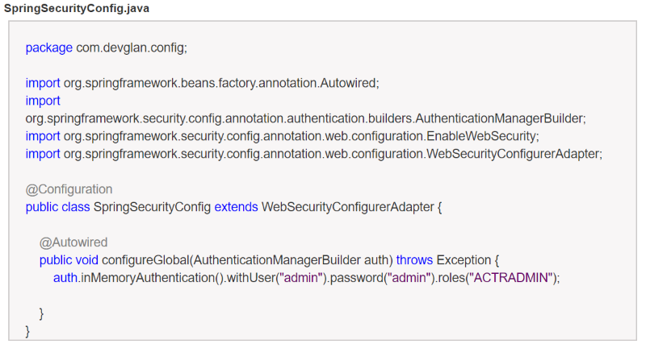
AuthenticationManagerBuilder

Slide 19
References/Resources
DevTools
https://dzone.com/articles/spring-boot-developer-tools-and-live-reload
http://www.baeldung.com/spring-boot-devtools
https://spring.io/blog/2015/06/17/devtools-in-spring-boot-1-3
https://docs.spring.io/spring-boot/docs/current/reference/html/using-boot-devtools.html
Actuators
https://dzone.com/articles/spring-boot-actuator-a-complete-guide
http://www.baeldung.com/spring-boot-actuators
https://spring.io/guides/gs/actuator-service/
https://docs.spring.io/spring-boot/docs/current/reference/html/production-ready.html
http://docs.spring.io/spring-boot/docs/current/reference/html/production-ready-endpoints.html

